Slide 1
Understanding of Quantum Science and Technology
From Blackbody Radiation to Quantum Information
“If you think you understand quantum mechanics, you don’t understand quantum mechanics.”
— Richard P. Feynman
Utsav Jignesh Karia
OVSRCS

Slide 2
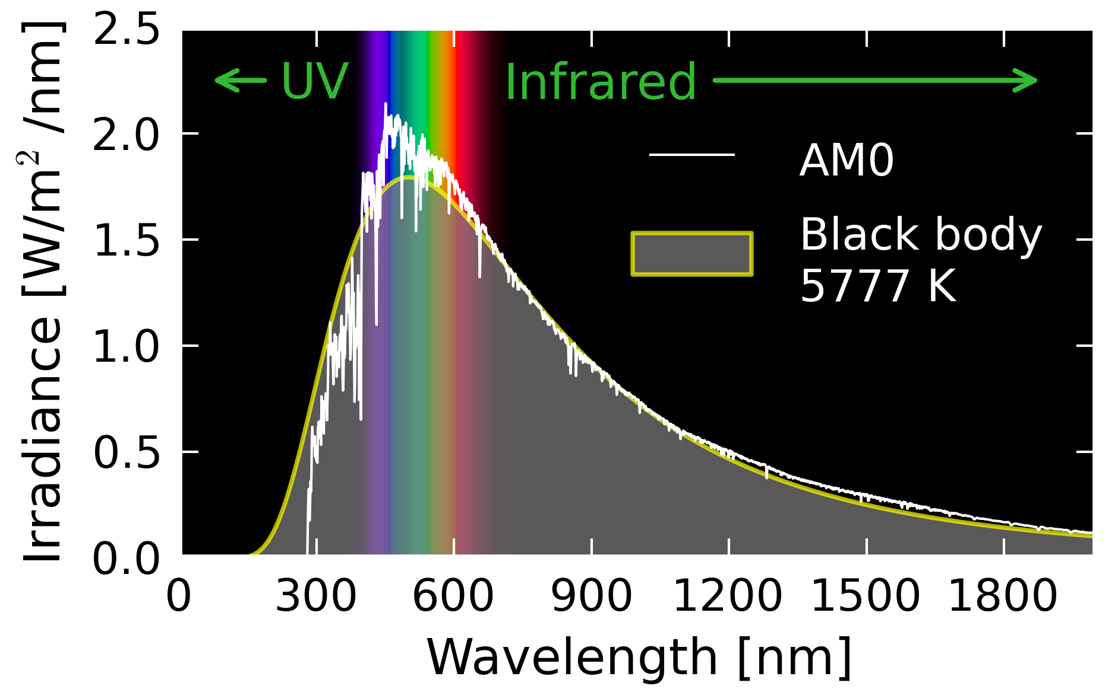
Origin of Quantum Mechanics:
Light emitted from light bulbs was measured at different temperatures
Physikalisch-Technische Reichsanstalt (PTR), Berlin
Experimental work: Lummer, Pringsheim, Rubens (1890s)

Slide 3

Classical Theory of Black-Body Radiation
Rayleigh–Jeans Law
Derived using classical electromagnetism
Assumes energy is continuous
Matches experiments only at long wavelengths only
Lord Rayleigh (1900),
Sir James Jeans (1905)

Slide 4
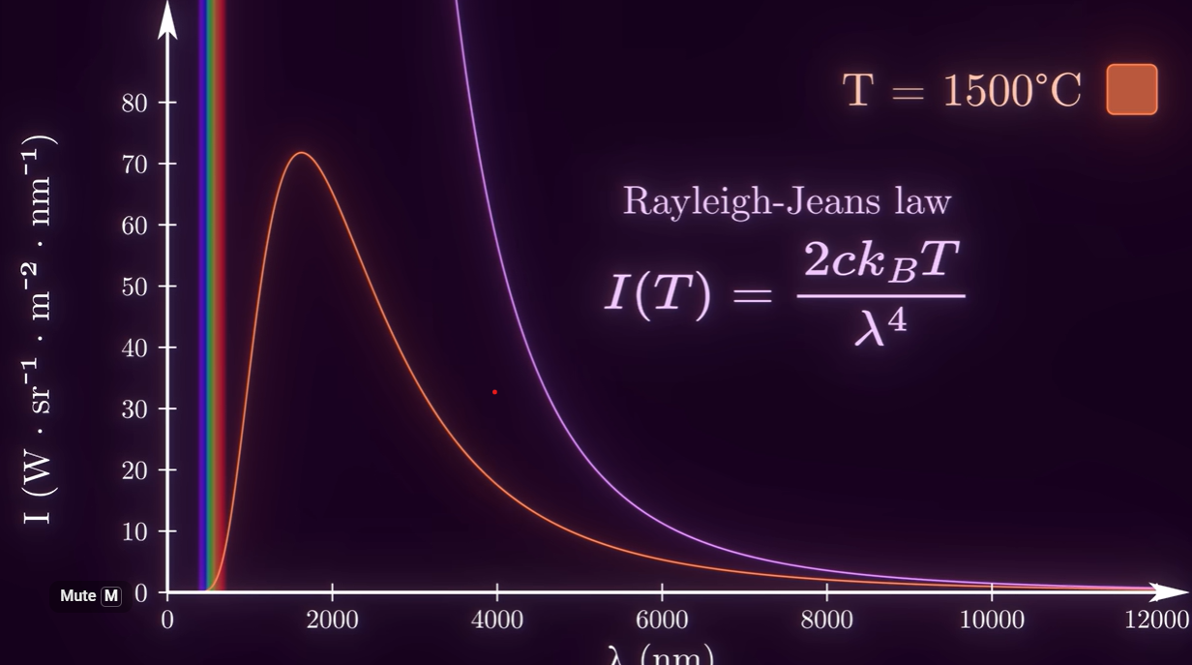
Ultraviolet Catastrophe

Slide 5

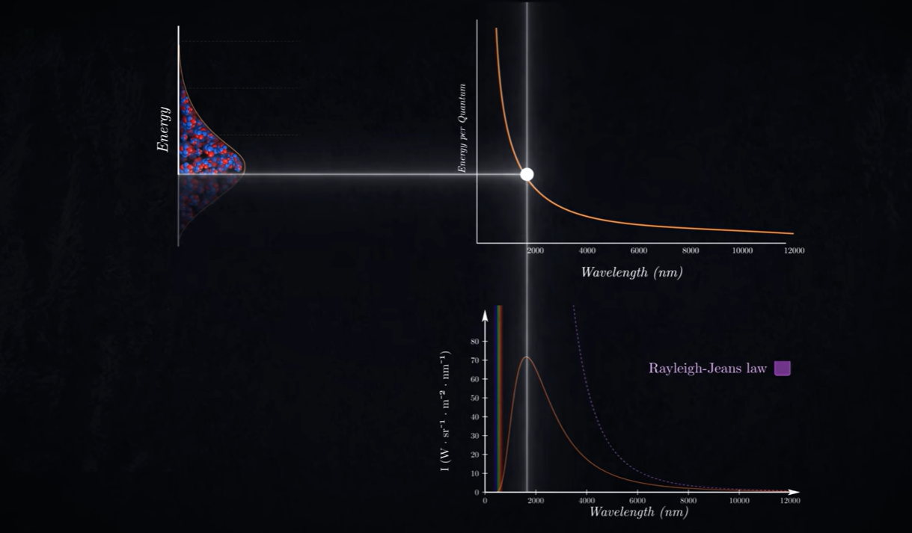
Planck’s Quantum Hypothesis (1900)

Slide 6
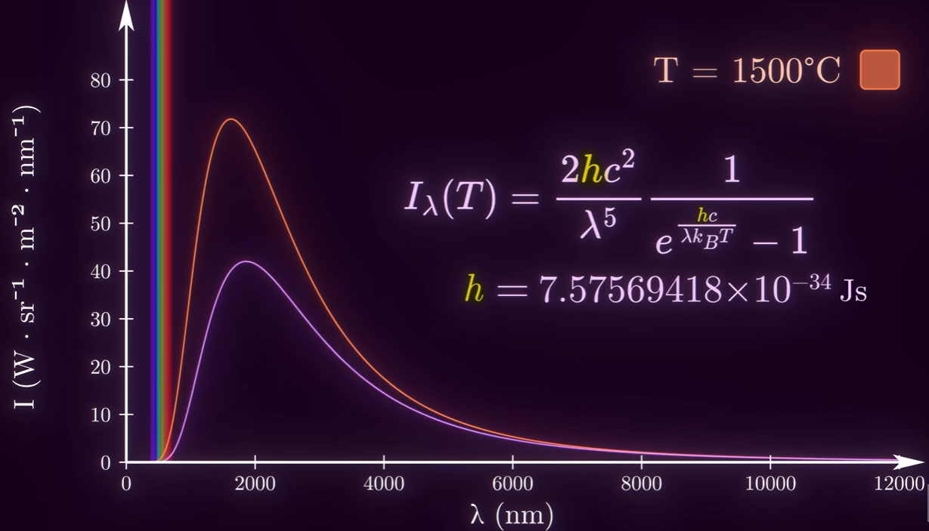
Planck’s Black Body Radiation Law

Slide 7

From Classical Particles to Quantum Waves
Not only light — matter itself behaves like a wave
Particles described by wavefunctions
Momentum ↔ wavelength
Sets the stage for quantum dynamics
de Broglie wavelength

Slide 8


Quantum States, Dynamics, and Measurement
State Evolution
Measurement & Probability
Schrödinger Equation
Born Rule
Quantum systems described by state vectors / wavefunctions
Time evolution is deterministic and unitary
Measurement outcomes are intrinsically probabilistic
Erwin Schrödinger (1926) · Max Born (1926)

Slide 9
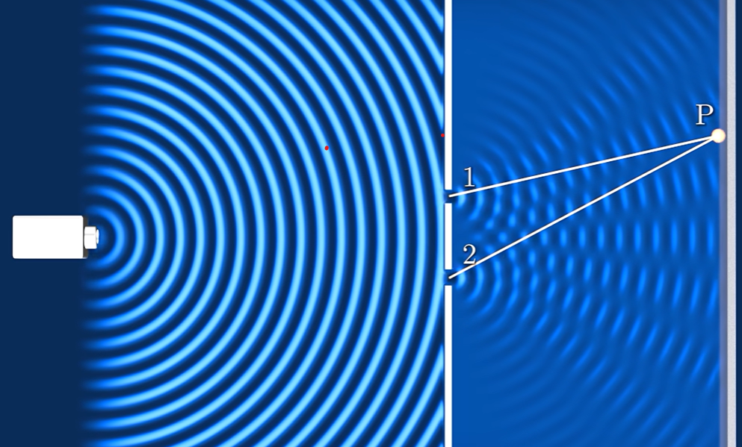
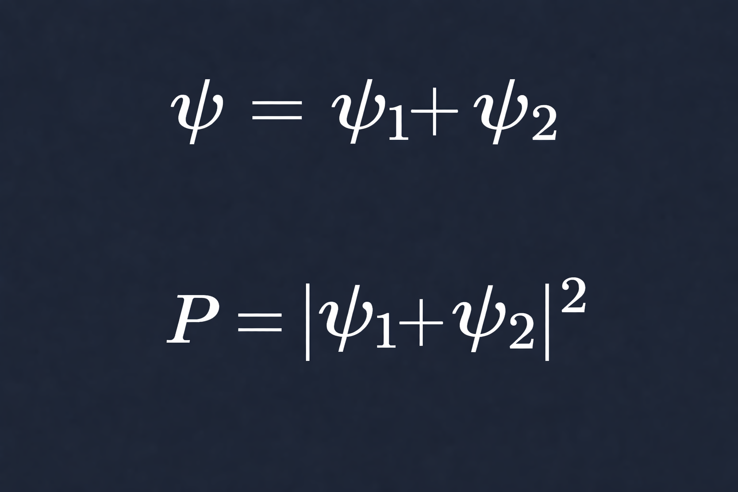
Double Slit Experiment

Slide 10

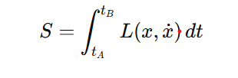
Light Takes Every Possible Path
Feynman Path Integral (1948)
Action functional

Slide 11
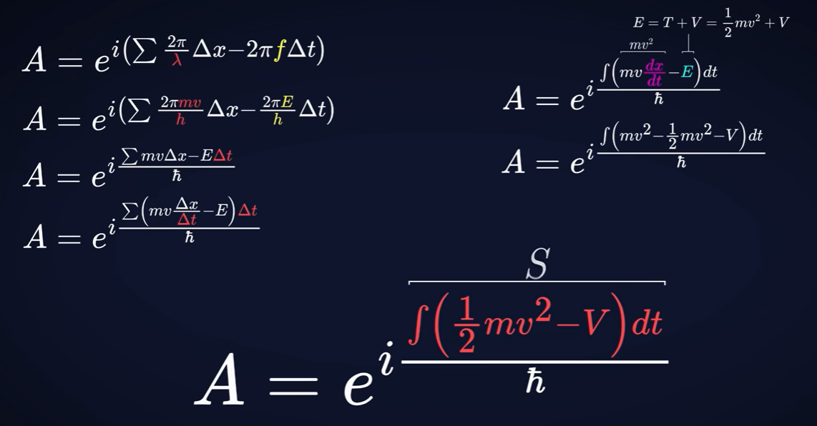
Derivation of Feynman Path Integral

Slide 12
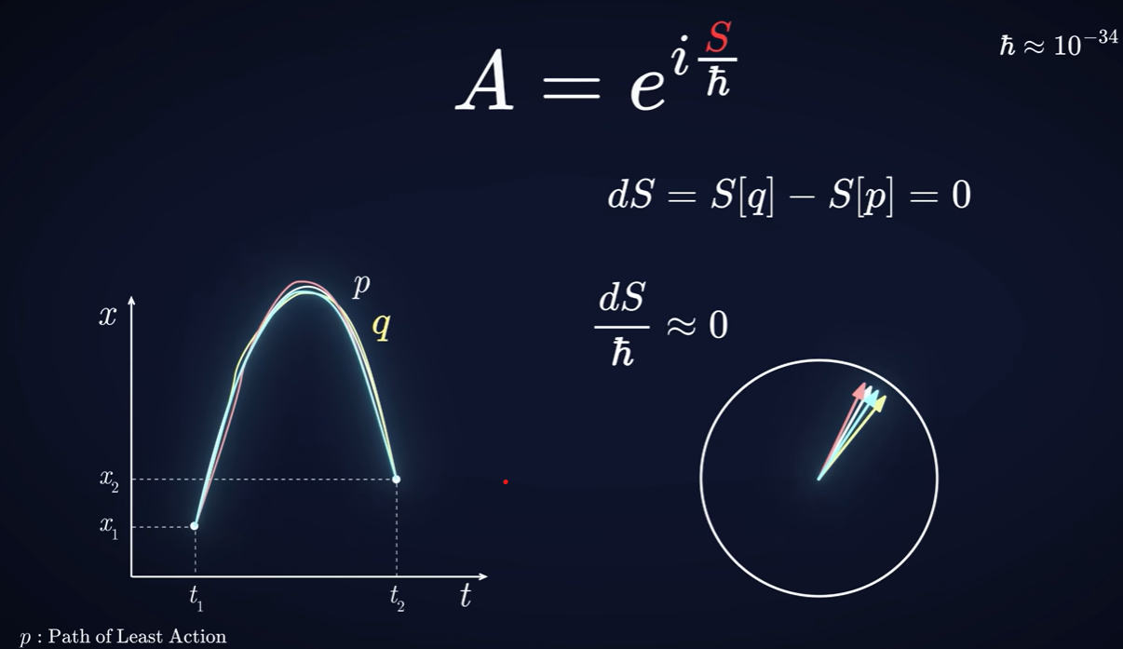

Light goes through all paths, but we only see Path of Least Action

Slide 13
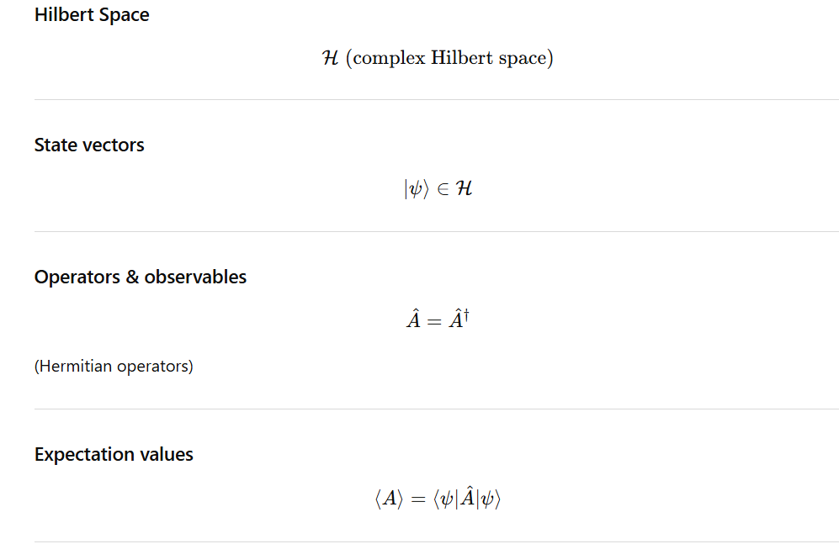
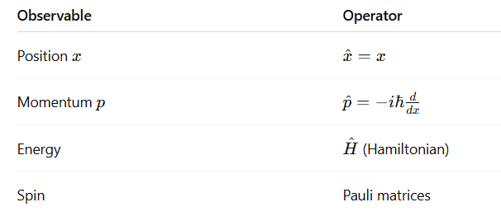
Mathematical Structure of Quantum Mechanics
Every physical observable is represented by a linear Hermitian operator acting on the Hilbert space
The average result of many measurements on identically prepared systems.

Slide 14
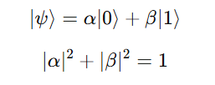

Quantum Computing
Bits
Qubits
Properties:
Definite state
Deterministic
No phase
One value at a time
Properties:
Superposition
Probabilistic outcomes
Phase matters
Interference possible

Slide 15


Quantum Gates and Unitary Evolution
Examples
Hadamard gate: creates superposition
Pauli-X: quantum NOT
CNOT: generates entanglement
Unitary Time Evolution
Unitarity preserves probability
Quantum Information Theory · Dirac · von Neumann

Slide 16

Limits of Quantum Search (BBBV’s Theorem)
No quantum algorithm can search an unstructured database in fewer than Ω(N) queries.
Applies to unstructured search
Rules out exponential speedup
Grover is provably optimal
Bennett · Bernstein · Brassard · Vazirani — 1997

Slide 17



Grover’s Algorithm: Geometric Interpretation
Initial Superposition ⇒
Grover Operator ⇒
Amplitude evolution ⇒
Iterations ⇒

Slide 18
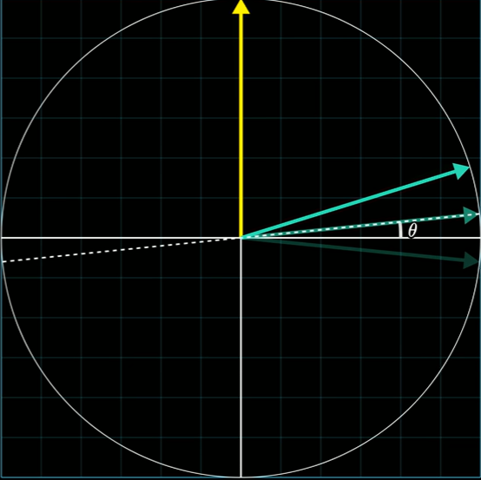
∣w⟩
O rotates is about ∣w⊥⟩
(2∣s⟩⟨s∣−I) rotates it about ∣s⟩
∣s⟩
∣w⊥⟩

Slide 19


Quantum Entanglement
Joint state cannot be factorized
Measurement outcomes are correlated
Resource for quantum technologies
Bell State
Classical Analogy
Einstein–Podolsky–Rosen (1935)
Bell (1964)

Slide 20


Non-Separability of Quantum States
Subsystems have no independent states
Only the joint system is well-defined
Correlations exceed classical limits
Entangled (Non-Separable) State
Separable (Classical-like) State
Schrödinger (1935) · EPR (1935)

Slide 21

Bell Inequalities: Testing Classical Reality
No local hidden-variable theory can reproduce all quantum predictions.
Classical (local realism): ≤ 2
Quantum mechanics: up to 2 sqrt(2)
Experiments violate the classical bound
CHSH Inequality
John S. Bell — 1964
Aspect (1982) · Loophole-free tests (2015)

Slide 22
Entanglement as a Physical Resource
Entanglement enables tasks impossible with classical correlations.
Key applications
Quantum teleportation → transmit an unknown quantum state
Superdense coding → send 2 classical bits using 1 qubit
Quantum cryptography (QKD) → provably secure communication
Quantum computing → speedups via correlated amplitudes
Bennett · Brassard · Popescu · Schumacher

Slide 23

Quantum Teleportation
Protocol
Shared entangled Bell pair
Bell-state measurement on sender’s side
Two classical bits sent
Unitary correction at receiver
State transfer, not particle transfer
Original state is destroyed
Bennett et al. — 1993

Slide 24

Decoherence: The Enemy of Quantum States
‘
Caused by interaction with environment
Destroys superposition & entanglement
Explains quantum → classical transition
Loss of coherence
Zurek · Joos · Schlosshauer

Slide 25


Quantum Noise Channels
General Quantum Channel
Kraus Representation
Trace Preservation

Slide 26




Amplitude Damping Channel
Phase Damping (Dephasing)
Depolarizing Channel

Slide 27

Noise modeled as CPTP maps
Decoherence suppresses off-diagonal terms
Fundamental limit to scalability
Lindblad Master Equation
Markovian Open Quantum Dynamics
Kraus · Lindblad · Gorini–Kossakowski–Sudarshan

Slide 28

Quantum Error Correction
Protects against decoherence & noise
Uses entanglement + redundancy
Requires fault-tolerant operations
Logical encoding
Shor (1995) · Steane (1996)

Slide 29



Two-Qubit Systems: The Minimal Quantum World
Smallest system that allows entanglement
Basis of teleportation & error correction
Decoherence effects become visible
General two-qubit pure state
Density Matrix for a pure Quantum State
Noisy Version
Quantum Information Theory

Slide 30


Quantum Biology: Quantum Effects in Living Systems
Quantum coherence and entanglement play functional roles in biological processes.
Examples:
Photosynthesis → coherent exciton transport
Avian magnetoreception → radical pair mechanism
Enzyme reactions → quantum tunneling Olfaction (hypothesis) → vibrational sensing
Photosynthetic coherence (density matrix form)
Radical pair spin dynamics
Engel et al. (2007) · Ritz et al. · Lambert et al.

Slide 31
Limits, Open Questions, and the Road Ahead
How long can coherence survive in real systems?
Can fault-tolerant quantum computing scale?
What are the ultimate limits of quantum speedup?
Does nature actively protect coherence (quantum biology)?
Where does quantum → classical truly emerge?
Quantum Information · Open Quantum Systems · Complexity Theory

Slide 32
The Big Picture
Quantum mechanics is not just strange — it is fundamental, powerful, and limited.
Quantum theory explains nature beyond classical intuition
Interference & entanglement enable new technologies
Decoherence sets fundamental limits
From light bulbs to quantum computers — the same theory governs it all.

Slide 33
Representing
Shri OV Sheth Lokvigyan Kendra Rajkot
Dr. P C Vaidya Center for Astronomy and Astrophysics
Acknowledgment
CA K T Hemani founder trustee of Saurashtra Education Foundation and OVS Lok Vigyan Kendra Rajkot
Dr. Anamik Shah ex-Vice Chanceller of Saurashtra University
Dr. Mihir Joshi Prof Emirates Atmiya University
Dr. Rameshbhai Bhayani Director OVS Lok Vigyan Kendra Rajkot who have inspired and supported me for research and study
Minesh C. Meghani Center Coordinator of Shri OV Sheth Regional Science Center Rajkot

Slide 34
Thank you Questions welcome

